Slide 1
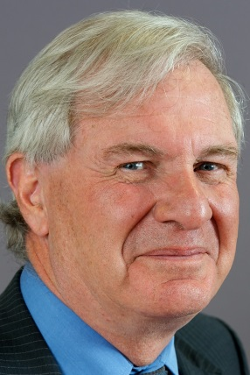
The Regional Approach: Which subjects can benefit of it?
Louis Delcart
Board Member EAR-AER

Slide 2
Summary
What is regional approach?
Role of regional authorities
Collaboration with civil society
Regional approach: what sectors benefit ?
Final remarks: the THREE CONCENTRIC CIRCLES model

Slide 3
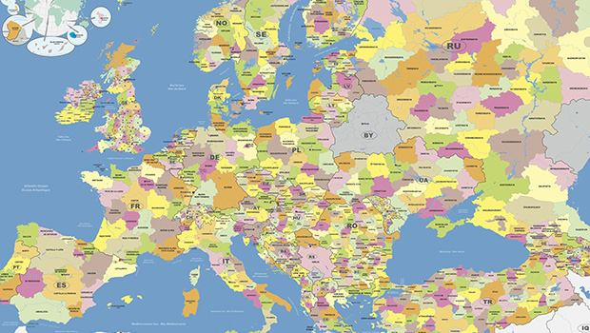
1.1 WHAT IS REGIONAL APPROACH?
supranational approach:
energy and water supply,
fight against pollution,
medical research and development,
anti-terrorist police actions
…
transnational collaboration
subnational approach:
Homogenizing forces of globalization endanger the local knowledge, relationships, and regionally diverse cultures that once connected people and place
→ require a specific approach, which often differs from the national policy.

Slide 4
1.2 WHY A REGIONAL APPROACH?
Human needs for natural resources and services largely rely on regional resilience
In many places, effective regional institutions are missing or underdeveloped
Human resilience is the capacity to shape and adapt to change and to encompass bundles of personal and social capacities
Notes:
Human resilience is the capacity to shape and adapt to change. We share with many others the definition of resilience as a capacity — and extend the definition to
encompass bundles of personal and social capacities Public and private individuals and organizations can cultivate these capacities through the application of
resilience in practice. While some of these principles and practices may be culturally specific, we have attempted to universalize our understandings and to describe resilience as a necessary capacity for communities and societies around the world

Slide 5
1.3 A Regional Approach
To describe some of the ways in which regional economies can bolster resilience, we posit the following:
Diversity within and among regions reduces vulnerability to stresses and shocks from climate change, disease, shortages, transmission or transport failures, and so on.
A greater diversity of production systems within and among regions offers greater opportunities for ownership, community investment, and social capital formation.
Regional trade networks offer opportunities for more immediate and transparent feedback about the true costs of production and consumption.
Regional trade networks offer opportunities for shared responsibility, stewardship, and community.
Especially when national and international institutions prove rigid and inflexible, the emergence of novelty and innovation at local and regional scales can be critical to leadership on global problems such as climate change.

Slide 6
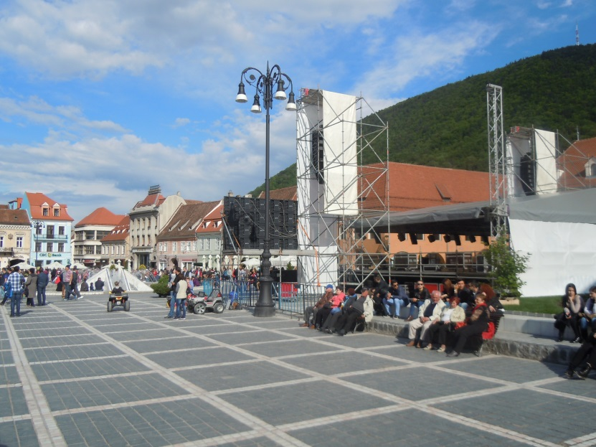
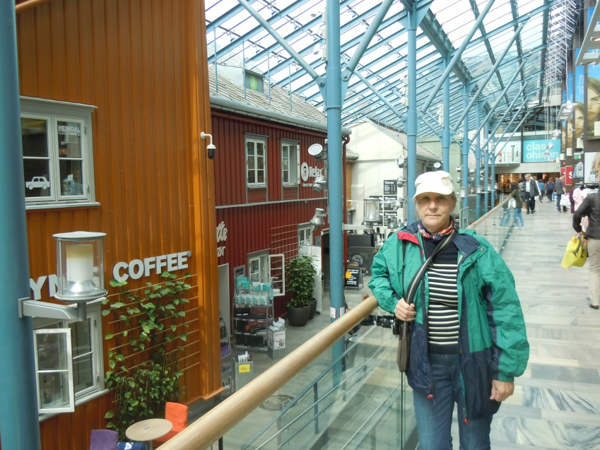
1.4. THE REGIONAL APPROACH: THE KEY FACTORS
RESILIENCE
COMMUNITY BUILDING
TRANSFORMATION & INNOVATION
ENTREPRENEURSHIP
Braşov
Trondheim

Slide 7
1.4.1.1 RESILIENCE
Resilience of what?
capacity for endurance
capacities for intentional adaptation and transformation
Resilience to what?
Resilience to types of environmental stresses such as energy price volatility and climate change
Resilience in human wellbeing systems, such as education and health care
Notes:
A loss of resilience translates into a vulnerability. In ecosystem management, for example, a focus on narrow objectives can undermine resilience and increase
vulnerability to environmental stresses. Attempts to optimize fish harvest have led to population crashes, and efforts to optimize production from forest, agricultural, and grazing lands can yield similar results.
The same can happen in supply chains as well. Efforts to optimize food distribution leave many big cities with limited food on hand at any time. They are vulnerable
to supply shocks, as evidenced in the aftermaths of Hurricane Katrina in 2005 and the Tōhoku earthquake in 2011. Greater functional diversity and redundancy — many types of distribution channels, supplying food from many types of sources — would increase food system resilience.
Resilience and transformation
As social and environmental threats to human wellbeing mount, it is becoming more evident that business as usual cannot continue. But what is business as usual — and why is it so difficult to change? In the language of resilience, business as usual represents a type of regime — a mutually reinforcing set of factors that create regularities in social-ecological interactions. These factors include value systems (worldviews, ideologies), institutions (social, political, economic), and material artifacts (infrastructures, technologies). Just as political regimes can become entrenched and resistant to change, dominant regimes that regulate our relationships to people and places — our economic systems, our energy systems, our food systems — develop a kind of inertia that makes them difficult to transform.
By definition, business as usual is the dominant regime, but others are possible. The local food, food sovereignty, and seed-saving movements have each created alternatives to the industrial food regime. The clean energy and climate stabilization movements present alternatives to the fossil fuel energy regime Alternatives to business as usual are all around us, but they have to surmount numerous formidable obstacles.

Slide 8
1.4.1.2 Resilience in Practice
Working with Nature
Connecting Value Chains
Strengthening Collaborative Management
Sharing Resources
Shifting to Renewables
Reforming Capitalism
Planning for Equity
Measuring What Matters
Deepening Democracy
Source: Resilience & Transformation - A Regional Approach, Ecotrust, Portland, Oregon, USA, ISSN 2166-188X
Notes:
Recommendations fopr reforming capitalism
• Develop institutions and innovations that strengthen corporate enterprise on behalf of the public good.
• Develop institutions and innovations that strengthen impact investing.
• Develop institutions and innovations that strengthen local and regional investment models.
• Develop institutions and innovations that strengthen community trust models.
Recommendations for planning equity
• Develop institutions and innovations that strengthen corporate enterprise on behalf of the public good.
• Develop institutions and innovations that strengthen impact investing.
• Develop institutions and innovations that strengthen local and regional investment models.
• Develop institutions and innovations that strengthen community trust models.
Recommendations for Measuring what matters
• Develop a richer understanding of the relationships between people and place and the specific factors that influence wellbeing.
• Develop maps and metrics to track wellbeing.
• Develop measures of wellbeing that are politically salient and can contribute to specific policy choices and outcomes.
Recommendations for deepening democracy
• Develop experiments in participatory decision making and governance.
• Protect citizen voices in the electoral process by removing special interests and supporting public-funding and other clean-election measures.
• Encourage legal protections to support the rights of communities and nature.

Slide 9
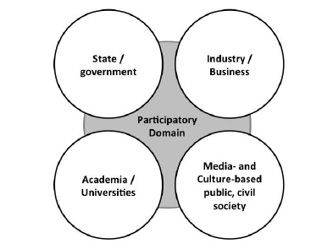
1.4.2 COMMUNITY BUILDING
The Triple Helix concept comprises three basic elements:
a more prominent role for the university in innovation, on a par with industry and government in a knowledge–based society;
a movement toward collaborative relationships among the three major institutional spheres, in which innovation policy is increasingly an outcome of interaction rather than a prescription from government;
in addition to fulfilling their traditional functions, each institutional sphere also “takes the role of the other” performing new roles as well as their traditional function.
The Quadruple helix adds a role for civil society as community spokesman. They detect the needs of a society in an organized way and try to find solutions with the three other parts.
Henry Etzkovitz: The Triple Helix in: William Sims Bainbridge, editor: Leadership in Science and Technology: A Reference Handbook, Sage, Los Angeles, pp. 434 sqq.

Slide 10
1.4.3.1 Transformation and innovation
dominant regimes that regulate our relationships to people and places — our economic systems, our energy systems, our food systems — develop a kind of inertia that makes them difficult to transform
By definition, business as usual is the dominant regime, but others are possible.
The local food, food sovereignty, and seed-saving movements have each created alternatives to the industrial food regime.
The clean energy and climate stabilization movements present alternatives to the fossil fuel energy regime.
Alternatives to business as usual are all around us, but they have to surmount numerous formidable obstacles.
Notes:
Our guiding questions:
What examples of institutional innovation are emerging?
How do these examples demonstrate resilience in practice?
Based on these examples, what recommendations can we make?

Slide 11
1.4.4. entrepreneurship
The Global Report for Entrepreneurship 2015-2016,confirms that in countries like Romania and Poland, the willingness to establish its own business is much higher than in an established Western-European economy like Belgium, and the fear of failure less high. The self-assurance of the young Eastern-European generation is much bigger than the one in Western-Europe and the entrepreneurial intentions much higher.
When it comes to looking for opportunities, it seems that the post-crisis period offers hope and expectations.
Several trends have to be considered and examined because they are potential creator of economic activity and jobs

Slide 12
1.4.4.1 Characteristics of Sustainable entrepreneurship
Digital economy
Innovation & creativity
Niche marketing
Localisation or internationalisation
Circular economy and other green economy initiatives
Notes:
Characteristics of sustainable entrepreneurship
When it comes to looking for opportunities, it seems that the post-crisis period offers hope and expectations. Several trends have to be considered and examined because they are potential creator of economic activity and jobs.

Slide 13
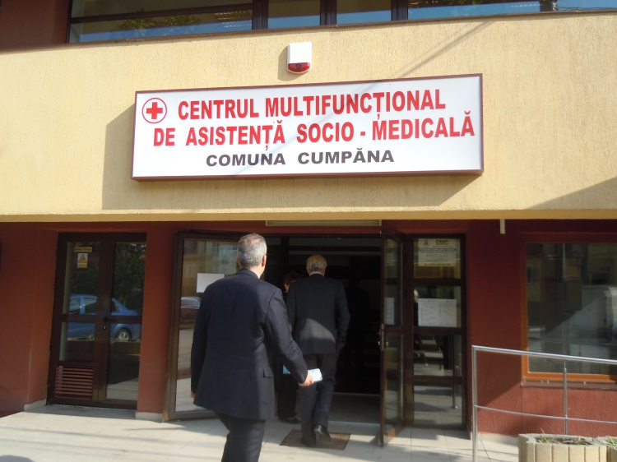
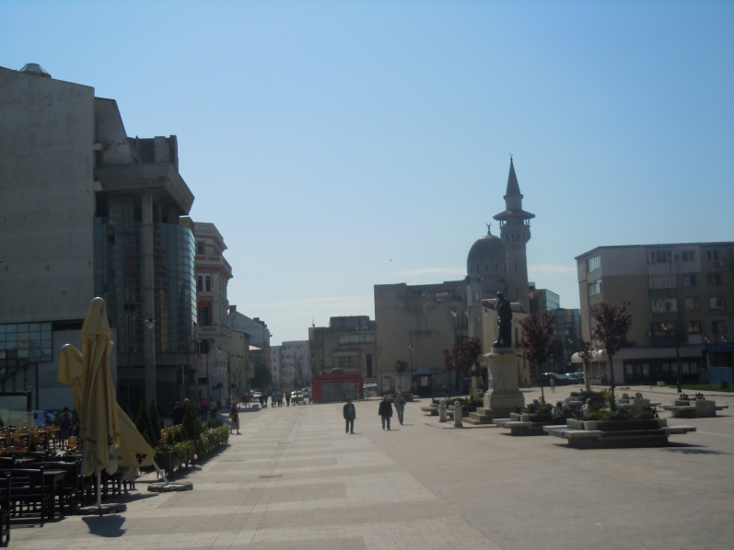
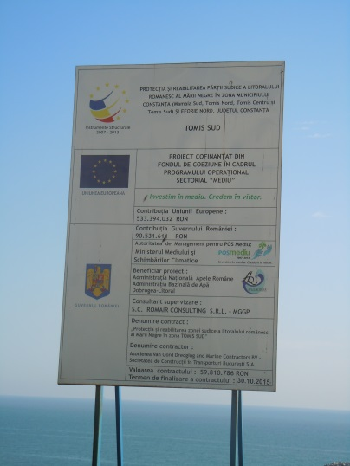
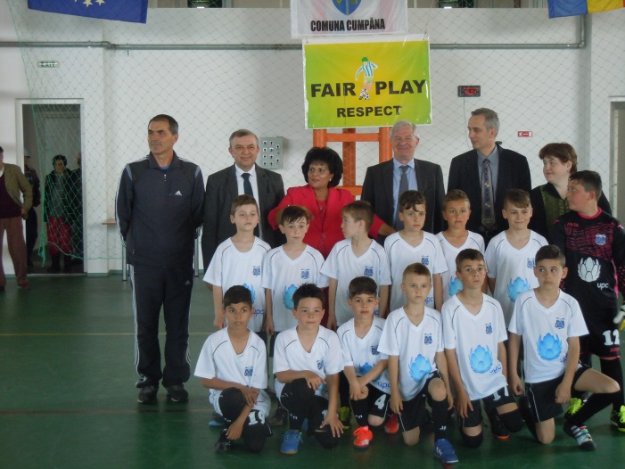
Examples from visited countries
Romania
Constanţa
Cumpăna

Slide 14
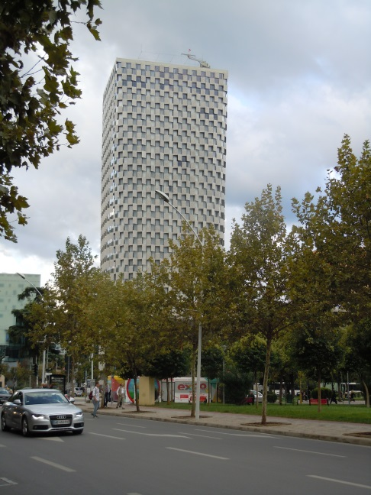
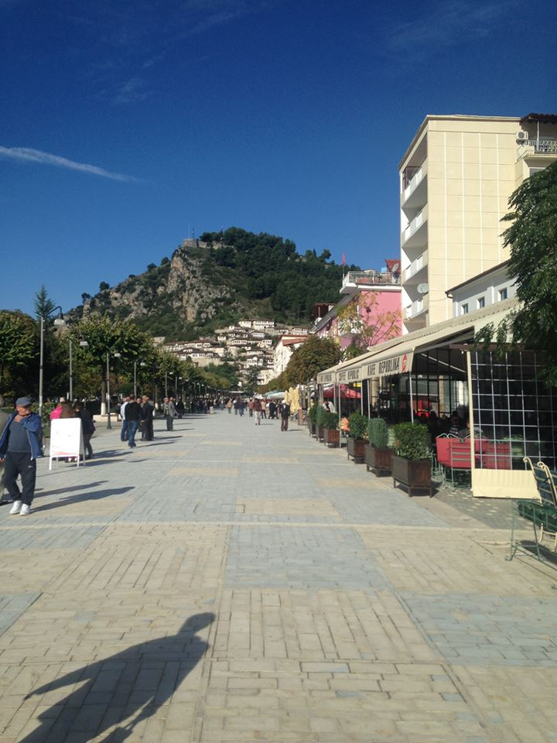
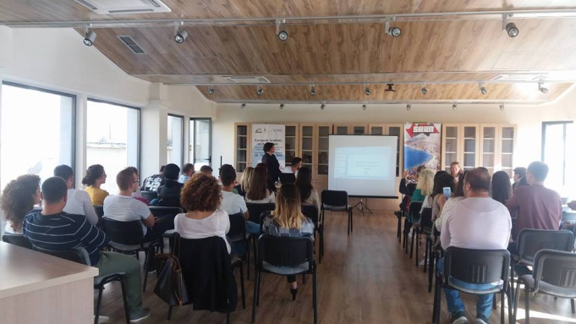
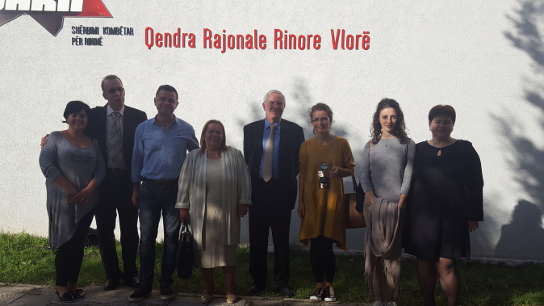
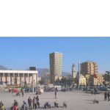
Examples from visited countries
Albania
Plaza Hotel
Berat
Vlorë Youth Centre
Urban Revival for local economy
Vlorë
Tiranë
51N4E

Slide 15
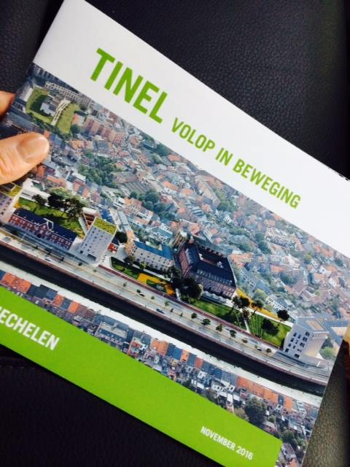
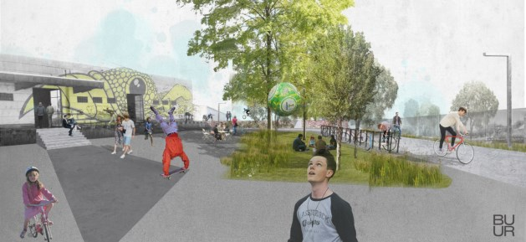
Examples from visited countries
Flanders: Mechelen
Douaneplein: Tussen de fuifzaal en de skatebowl moet de indoor skateruimte komen
De Tinelsite zal de komende jaren een metamorfose ondergaan. met de stadsbibliotheek in het Predikherenklooster, een publieke ondergrondse parking, een 70-tal woningen en het Tinelpark van de Goswin de Stassart-straat tot aan de Van Busleydenstraat.

Slide 16
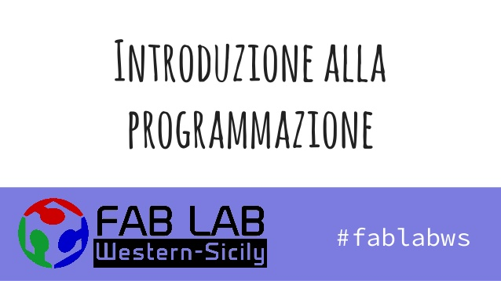
Examples from visited countries
Italy: Sicily
Fab Lab Western Sicily – Il primo Fab Lab a Marsala, provincia di Trapani
Crowdfunding operation
https://schoolraising.it/progetti/fablabws/Examples from visited countries
Impara anche tu a costruire il tuo gadget 3D personalizzato!

Slide 17
2.1. Role of regional AND LOCAL authorities
Regional authorities have to create the circumstances and sometimes to interfere in an overall capitalistic scheme
Regional authorities have to give the floor to civil society and involve them in common debates is mostly the role of an active regional authority
Regional authorities have to persuade the key players on the field to collaborate around a regional strategic plan

Slide 18
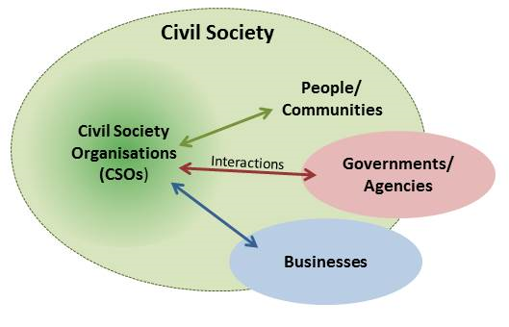
3.1. Give the floor to civil society
A dynamic social and political environment disposes of a civil society.
That civil society promotes a better, healthier and happier society as a whole:
Chambers of commerce,
labour organisations,
cultural organisations,
health care organisations,
universities and technical university colleges play an important role in a regional civil society.
Each of them promotes of course the needs of the group they represent.
They try to be influential in the first place on a supranational and/or a national level
But: they need local antennas
Notes:
A dynamic social and political environment disposes of a civil society. That civil society can be promoted with governmental input, but also through memberships and/or sponsoring. That civil society promotes a better, healthier and happier society as a whole. Chambers of commerce, labour organisations, cultural organisations, health care organisations, universities and technical university colleges play an important role in a regional civil society. Giving them the floor and involving them in common debates is mostly the role of an active regional authority. The civil society is closely involved to what lives in the community in general. They recognise (lack of) expertise, they recognise institutional, social and economic needs. Each of them promotes of course the needs of the group they represent. Looking for consensus and making choices for coping with the most urgent needs in a region, that is the art of negotiation and compromise.
Chambers of commerce mostly represent the industrial and entrepreneurial tissue. They have a key role to play on a regional basis in order to maintain and promote an industrial tissue of a region. They are the ones that can recognise high potential companies and monitor and pamper them. They are the ones that can recognise training needs for the majority of the companies and cope with it directly –by organising training themselves- or indirectly –by persuading the regular educational institutions to create the necessary programs. They are the ones that advocate the interests of enterprises towards the local, regional and national authorities and try to stimulate governments to develop a company and labour friendly policy. They are the ones that bring company managers of high and middle management together in order to exchange ideas, experience but business opportunities as well.

Slide 19
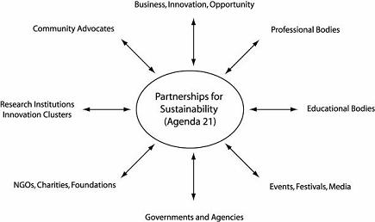
3.1. Role of civil society in less developed areas of Europe
Have to work hard to develop a regional policy to survive
Development of factories and companies in these areas have to see light mostly from own initiatives
Need for a strong civil society especially in those areas
The civil society recognises talent,
The civil society monitors development
The civil society promotes solidarity with the local population
Notes:
Europe is advancing at two or three speeds. There are the key areas of the continent that are traditionally densely populated and therefore attract the majority of the large companies, that want to be close to their markets and dispose of a large pool of potential employees. There are the remote areas of the key countries with a lot of positive development, with less population and therefore less attractivity to large companies. They have to focus on tackling specific needs for their region or clustering separate companies in order to propose finished products and jointly promote them in the main economic area of their country or abroad. The two categories appear a second time in less developed countries in Europe. The latters’ densely populated areas attract the most important FDIs. The remote areas have to work hard to develop a regional policy to survive. Development of factories and companies in these areas have to see light mostly from own initiatives. So the need for a strong civil society especially in those areas, that recognises talent, monitors development and promotes solidarity with the local population is paramount.

Slide 20
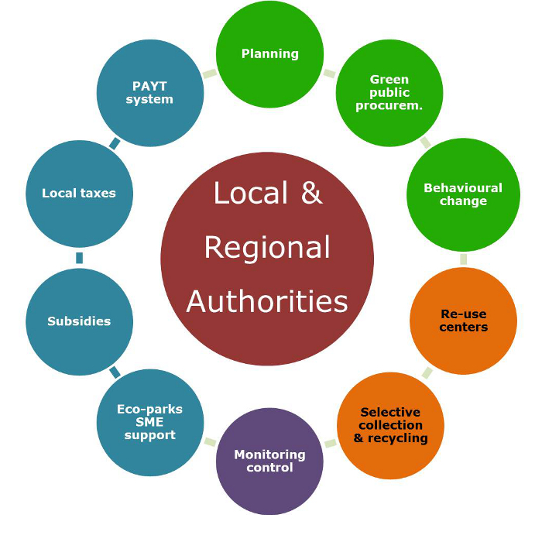
4.1. THE REGIONAL APPROACH: WHICH SUBJECTS CAN HAVE A BENEFIT THROUGH IT?
Economic development
Educational development
Medical care
Public utility functions
Public property
Cultural development
The cross-border level
http://lodelcar.tumblr.com/post/150361014205/the-regional-approach-which-subjects-can-have-a?og=1
Notes:
Economic development.
Regions should dispose of instruments to stimulate economic development such as funds for stimulation of innovation, internationalisation or localisation, credit guarantee tools, … Methodologies to stimulate the best projects are to be developed in order to stimulate transparency. Monitoring and stimulating the development of sustainable MSME’s together with the civil society is a key role to be played by the regional level.
Due to the development of renewable energy in the coming years, and the fact that companies and individuals will be able to contribute to this type of energy, putting the energy they produce on the public network thanks to smart grids, the choice of a type of renewable energy and the stimulation of citizens and SMEs to produce it, can vary from region to region. In the North of Italy the focus lies on hydro-energy whereas in the south of Italy, photovoltaic energy is the key lever for sustainable economic development.
Educational development
Universities with a national interest should continue to be managed on a national level. We also believe that salaries of kindergarten, primary school and high school teachers should remain a national matter, based upon operational hour/credit points provided schools are public. Tuition fees for private schools vary from county to county and are subject of market conditions. The quality of the output of schools, should be identical though and heavily controlled by the authorities, be they regional or national.
The management and distribution of the allotted credit points to public schools can be regional matter. Matters that can also be governed on a regional basis are a.o. construction and maintenance of schools, after school facilities, post-compulsory education facilities, professional reorientation facilities, etc.
Medical care
Hospitals, day-care centers, elderly care instruments, child care locations, dispensaries and medical care centers: these topics are better organised on a regional level. The region can centralise the most specialised and most expensive services in one location, but at a distance and at a price that is reachable by the majority of the population. The region can decide to expand medical education and prevention efforts when it discovers a backlog of the population compared to other parts of the country.
The medical function is often also a sector that employs a lot of volunteers. Unemployed people, retired people but also house wives make themselves useful in giving assistance to doctors, elderly people, young mothers with children. It is important that organisations who put them at work provide them with the necessary framework. Managing volunteers requires special skills, but also insurance in case of errors or accidents.

Slide 21
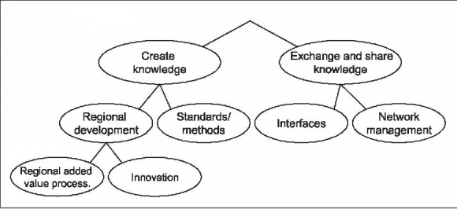
4.1. THE REGIONAL APPROACH: WHICH SUBJECTS CAN HAVE A BENEFIT THROUGH IT?
Notes:
Public utility functions
Public utility functions such as collection of garbage, organisation of regional public transportation, urbanisation planning, city renovation, fire fight brigades are best organised on a regional level. The advantage is financial in the first place. Machinery and equipment can be used more efficiently, maintenance can be organised in one location, public procurement of new material will receive better prices because of larger quantities to purchase. The control of the quality of the service, of the financial efficiency, of the respect of national rules can be organised on a regional level under national supervision.
Regions have a good overview of major calamities that could happen (earthquakes, large explosions, multiple car crashes, train accidents, terrorist attacks, football hooligans violence…). They should not only dispose of a regional emergency plan, but also of local municipal antennas that are prepared and have access to national calamity fighters, such as civil protection squads, specialised fire fight squads, crisis police teams, demining teams…)
Public property
Public works and maintenance of public property, except for waterways, motorways, railways and interregional roads, can also better be organised on a regional level. A region is more accepted by the population to decide which measures to take and which priorities to establish. Municipalities can foresee playground furniture and sport infrastructure giving a future to the youth, possibly in collaboration with the local community and/or civil society for the maintenance and the social control.
Financial responsibility is in this case the key word, but under the supervision of the national level. Examples of bad policy by regions can be quoted in many countries. But this is not a reason for not doing this. There is more public consensus on a regional level than on a national one. Regional levels can also motivate better the necessity of an investment because more closely involved, especially when European funds are at stake. It is sad therefore that the investment proposal for the last Juncker funds had to be produced quickly by the national level, without the involvement of the regions.
Cultural development
Cultural development is the most tricky subject, when it comes to the regional approach. Often, historic disputes started because of different cultural origins or exteriorisation of minorities considering themselves as backlogged by the cultural majority. Slovaks and Czech decided on a separation into two countries for these reasons. Catalunya is claiming independence for the same reason. As does Corsica, Flanders, Bask country, Scotland etc. Flanders is a strange example, because representing the majority in Belgium, but not being considered abroad as such. But culture is not only based upon language. Culture needs a place in the life of a community. All types of art, from popular music to cinema, and TV series and programs, from graffiti over street art to paintings and sculpture, from music; opera and theatre, from magazines and newspapers to novels and poetry, they are needed by a population to express itself. Religion, religious buildings and religious expression are also part of the cultural life of a region and/or of a minority living in that region. A region is much more able to give a place to all these elements, because constantly confronted with the real situation. This implies in the first place topics such as the construction, maintenance and development of museums, theatres, cultural centres, exhibition centres, concert halls. It also implies the stimulation of cultural expression. Here also the use of volunteers is frequent and requires a special attention.
Exceptions can be made for cultural groups of national interest such as opera houses, symphonic orchestras, television and radio stations, who should continue to be managed on a national level.
It is my point of view that every initiative taken as well on regional as on national level can be subject to public-private-partnerships. Specific legislation should determine the methodologies that could be used (concessions, PPP projects, …) and the methodologies for attribution of contracts. The same principle goes for appeal on European Funds. Attribution of EFRD funds could be regionalised as well as the monitoring of the projects. Collaboration between regions and foreign regions in the framework of Interreg, Horizon 2020 and other European funds can be decided and monitored on regional level.

Slide 22
4.2. THE REGIONAL APPROACH: To be maintained on a national level
Social security system (health insurance, retirement insurance, unemployment insurance)
Army and inland security troops, calamity fight agencies (civil protection, …)
Customs
National security agencies
Legal system and Justice
Tax collection
Public enterprises such Post, Train, Air company
International trade agreements, international police agreements, international custom agreements, …

Slide 23
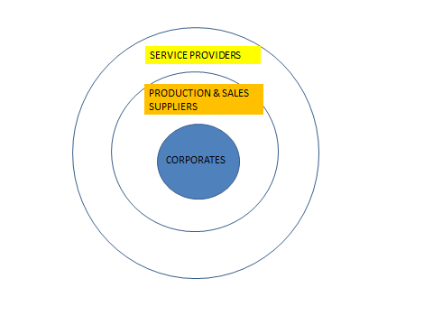
6. Final considerations: the three CONCENTRIC circles model
Large companies create a lot of employment. Not only inside their own entity but also to suppliers. And suppliers are to be defined in several categories: suppliers of spare parts, suppliers of services such as accountancy, HRM, legal advice, ICT, finance, marketing and advertising, suppliers of catering, cleaning. And then there is the third circle of opportunities: those companies that offer products and services to everybody that has a proper salary: food service industry, shops, construction companies.
This model of the three concentric circles becomes stronger when the inner circle is not based upon one or two large companies with foreign management, but on more medium sized national companies with unique features in the market and innovative capacity.
http://lodelcar.tumblr.com/post/143795680400/corporate-social-responsibility-in-regional?is_related_post=1
Notes:
Why are industrial businesses important for a regional economic structure especially in less developed areas? Large companies create a lot of employment. Not only inside their own entity but also to suppliers. And suppliers are to be defined in several categories: suppliers of spare parts, suppliers of services such as accountancy, HRM, legal advice, ICT, finance, marketing and advertising, suppliers of catering, cleaning. And then there is the third circle of opportunities: those companies that offer products and services to everybody that has a proper salary: food service industry, shops, construction companies. This model of the three circles becomes stronger when the inner circle is not based upon one or two large companies with foreign management, but on more medium sized national companies with unique features in the market and innovative capacity.

Slide 24
Thank you
http://lodelcar.tumblr.com/

